Slide 1

Gokaraju Rangaraju Institute of Engineering and Technology
(Autonomous)
Department of Data Science
Mini Project Work
(CSE(DS))
Review 3: Module Presentation
Batch No -10
Presented By:
1.Abhinav U (22241A6767)
2.Jasti Amit (22241A6793)
3.Medhansh K (22241A6799)
Under the Guidance of:
Dr. Mamidi Kiran Kumar
Associate Professor
Department of Data Science

Slide 2
Smart Investment Planner Using ML

Slide 3
Abstract
This project assists investors in making data-driven investment decisions by analyzing historical stock data from YFinance. It retrieves stock prices for selected companies and computes key financial metrics, including annualized returns, volatility, and the Sharpe ratio. Based on user inputs such as investment amount, duration (short-term or long-term), and risk tolerance, the system recommends a suitable company by filtering stocks according to risk-adjusted return metrics and estimating potential gains. Additionally, the project features a visualization component that plots historical stock prices, helping investors assess market trends. YFinance data includes historical and real-time stock prices, company fundamentals, financial statements, and valuation metrics, enabling informed investment decisions while considering market risks.

Slide 4
Problem Statement
Investors often face challenges in selecting the best stocks based on their investment capacity, risk tolerance, and investment duration. Additionally, the high volatility of stock prices and real-time market fluctuations make it difficult to make informed decisions. Traditional forecasting methods may not effectively capture the nonlinear and non-stationary nature of stock price movements, leading to inaccurate predictions . To address this challenge, Hilbert-Huang Transform (HHT) and Temporal Convolutional Network (TCN)-based stock prediction model is developed. The model first decomposes stock price trends using EMD to extract relevant features, helping to capture underlying patterns in the data. It then leverages TCN to learn historical price patterns and predict future stock prices with improved accuracy.

Slide 5
Objectives
Live Market Data Integration – Fetch real-time stock prices to ensure recommendations are based on the latest market trends.
Extracting the Intrinsic Mode function using the Hilbert-Huang Transform (HTT) and advanced algorithms.
Forecasting the trends using the advanced techniques like Temporal convolutional Network
Risk Assessment – Categorize stocks based on risk levels and align them with the investor’s risk tolerance.

Slide 6
Hardware and Software Requirements
Hardware Requirements
Software Requirements
Operating System:
Windows 10/11 (64-bit)
macOS (10.15 Catalina or later)
Linux (Ubuntu 18.04 or later)
Processor (CPU): Intel Core i5 (or equivalent) and above (Recommended: Intel Core i7 or AMD Ryzen 5 and above)
Memory (RAM): Minimum 8GB (Recommended: 16GB or higher for better performance)
Python Version: Python 3.7 or later
Storage: Minimum 10GB free space (Recommended: SSD for faster performance)
Required Python Libraries

Slide 7
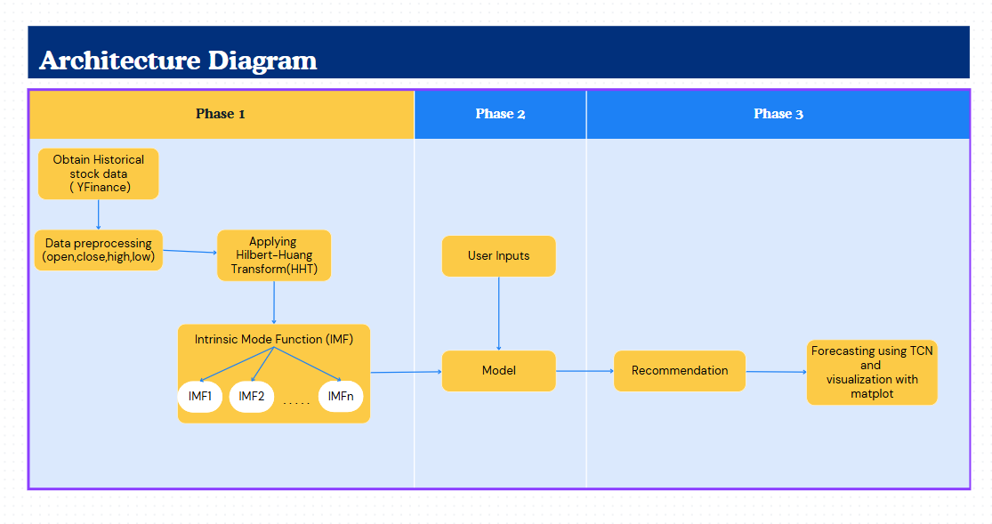
Architecture Diagram

Slide 8
Research Gaps
Some Models primarily relies on historical data, which may not capture sudden market changes or real-time events.
And some models from above papers does not integrate with the real time market movements and prices.
From the above mentiond papers some only mainly focuses on short-term predictions but does not address long-term investment strategies.

Slide 9
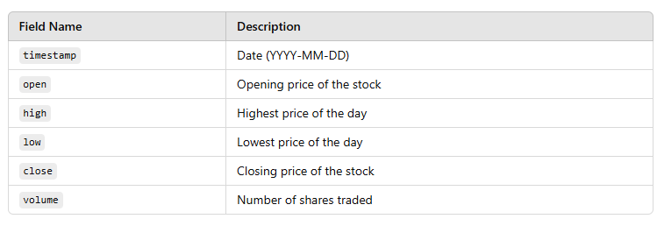
Dataset Details
Dataset Link:https://www.alphavantage.co/documentation/
Dataset Fields:

Slide 10
Source | Research Objective or Research Question | Methodology | Key Findings | Techniques | Accuracy & Performance Measures | Advantages | Disadvantages
Predicting Stock Market Trends Using Machine Learning and Deep Learning Algorithms Via Continuous and Binary Data; Analysis
Improve stock trend prediction accuracy by analyzing both continuous and binary financial data using ML and DL models.
Deep learning models outperform traditional ML models by effectively capturing complex patterns in mixed data formats.
Utilizes ML models (SVM, Random Forest) and DL models (LSTM, CNN) with continuous and binary data for trend classification.
87%–90% trend prediction accuracy.
Decision Tree, Random Forest, Naive Bayes, K-Nearest Neighbors
Enhanced Predictive
Performance And More Accurate
High Cost
&
More Complexity
A Novel Integrated Approach for Stock Prediction Based on Modal Decomposition Technology and Machine Learning
Enhance stock prediction accuracy by integrating modal decomposition with machine learning.
LSTM (Long Short-Term Memory), CEEMDAN
The hybrid model improves forecasting precision by effectively reducing noise and capturing market trends.
Combines modal decomposition (e.g., EMD, VMD) with ML models like LSTM, SVM, or XGBoost.
Improved Predictive
Performance ,
Effective
Noise Reduction
&
Provides Consistent performance
Computational Complexity
&
Limited Pattern Exploration
85%–90% trend prediction accuracy.
A systematic review of stock market prediction using ML and statistical techniques
Overview of ML and statistical techniques in stock prediction.
Reviewed 30 papers covering ML and statistical techniques.
ANN and NN are widely used in prediction.
ANN, Statistical Methods
75% trend prediction accuracy.
Highlights the power of ANN and NN.
Lacks performance comparison

Slide 11
Source | Research Objective or Research Question | Methodology | Key Findings | Techniques | Accuracy & Performance Measures | Advantages | Disadvantages
Machine learning approaches in stock market prediction: A systematic literature review
Reviewed 30 studies on ML models like SVM and Neural Networks.
Neural networks are commonly used for stock prediction.
Review ML techniques in stock prediction.
Neural Networks, SVM
84% trend prediction accuracy.
Provides a broad ML review for stock prediction.
No empirical performance data.
Stock market prediction using machine learning: A study on the Indian stock market
Used historical stock data, financial news, and ML models like LSTM and SVM.
Analyze and predict the Indian stock market.
Social indicators improve stock market predictions.
LSTM, SVM, KNN, Random Forest
Achieved minimized RMSE error.
Uses multiple data sources for better accuracy.
Computationally expensive.
A systematic review of stock market prediction using ML and statistical techniques
Overview of ML and statistical techniques in stock prediction.
Reviewed 30 papers covering ML and statistical techniques.
ANN and NN are widely used in prediction.
ANN, Statistical Methods
75% trend prediction accuracy.
Highlights the power of ANN and NN.
Lacks performance comparison

Slide 12
Source | Research Objective or Research Question | Methodology | Key Findings | Techniques | Accuracy & Performance Measures | Advantages | Disadvantages
The Stock Exchange Prediction using ML Techniques: A Systematic Review
Identify research trends, datasets, and models in stock prediction.
Analyzed 81 studies focusing on classification and estimation.
Classification and estimation are the most used methods.
Classification, Estimation, Clustering
Provides an in-depth trend analysis.
No model performance evaluation.
Approx 77% Accuracy
Stock Market Prediction Using ML Techniques
Compared models like LSTM, XGBoost, and ARIMA on Tesla stock.
Compares multiple ML models.
Predict stock trends using ML models.
LSTM had the best prediction accuracy.
LSTM, XGBoost, ARIMA
85% trend prediction accuracy.
High computational cost.
Applied Linear Regression, Decision Trees, and SVM on historical data.
Dataset limitations affect generalization.
Stock Market Prediction Using Advanced ML
Analyze stock data and predict future trends.
SVM performed better than other models.
Linear Regression, SVM, Decision Trees
Approx 79% Accuracy
Proves ML effectiveness in finance.

Slide 13
Source | Research Objective or Research Question | Methodology | Key Findings | Techniques | Accuracy & Performance Measures | Advantages | Disadvantages
A Survey of ML-Based Approaches for Stock Market Prediction
Compared various ML methods for stock forecasting.
Deep learning models show high predictive power.
Comprehensive review of ML in stock forecasting.
No empirical performance data.
Review ML techniques for stock forecasting.
Various ML Models
~80% trend prediction accuracy.
Stock Market Prediction using ML Algorithm
Predict stock market trends using ML models.
Used LSTM on historical stock data for trend prediction.
LSTM achieved 84% accuracy in trend forecasting.
Shows LSTM’s ability to capture trends.
Focuses only on LSTM, limiting comparison
LSTM, RNN
Approx 84% Accuracy
A Deep Learning-Based Approach for Stock Market Prediction
Deep learning models outperform traditional methods.
High computational cost for training.
Explore deep learning for stock forecasting.
Applied CNN-LSTM hybrid models on historical data.
CNN-LSTM outperformed traditional ML models.
CNN, LSTM, Hybrid Deep Learning Models
~87% trend prediction accuracy.

Slide 14
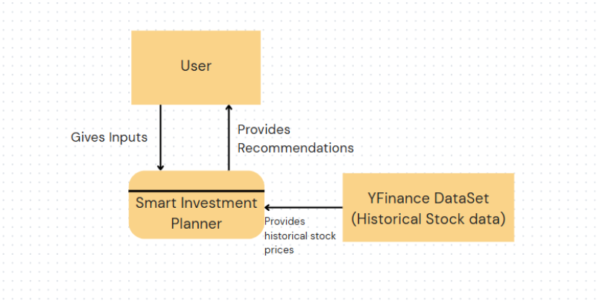
Level 0 DataFlow Diagram

Slide 15
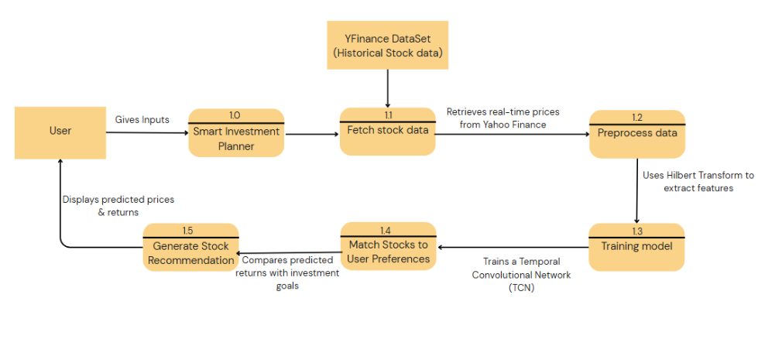
Level 1 DataFlow Diagram

Slide 17
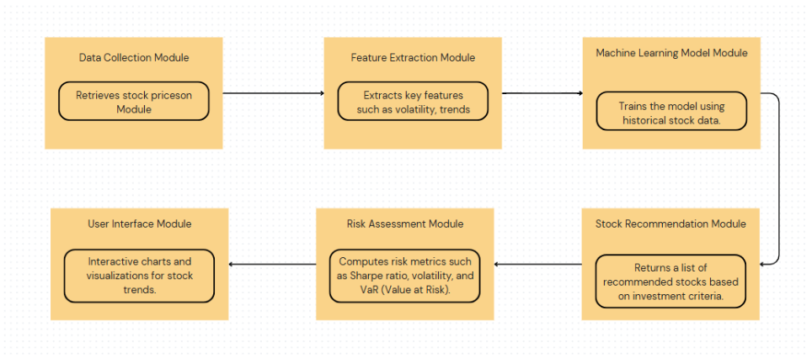
Module Connectivity Diagram

Slide 18
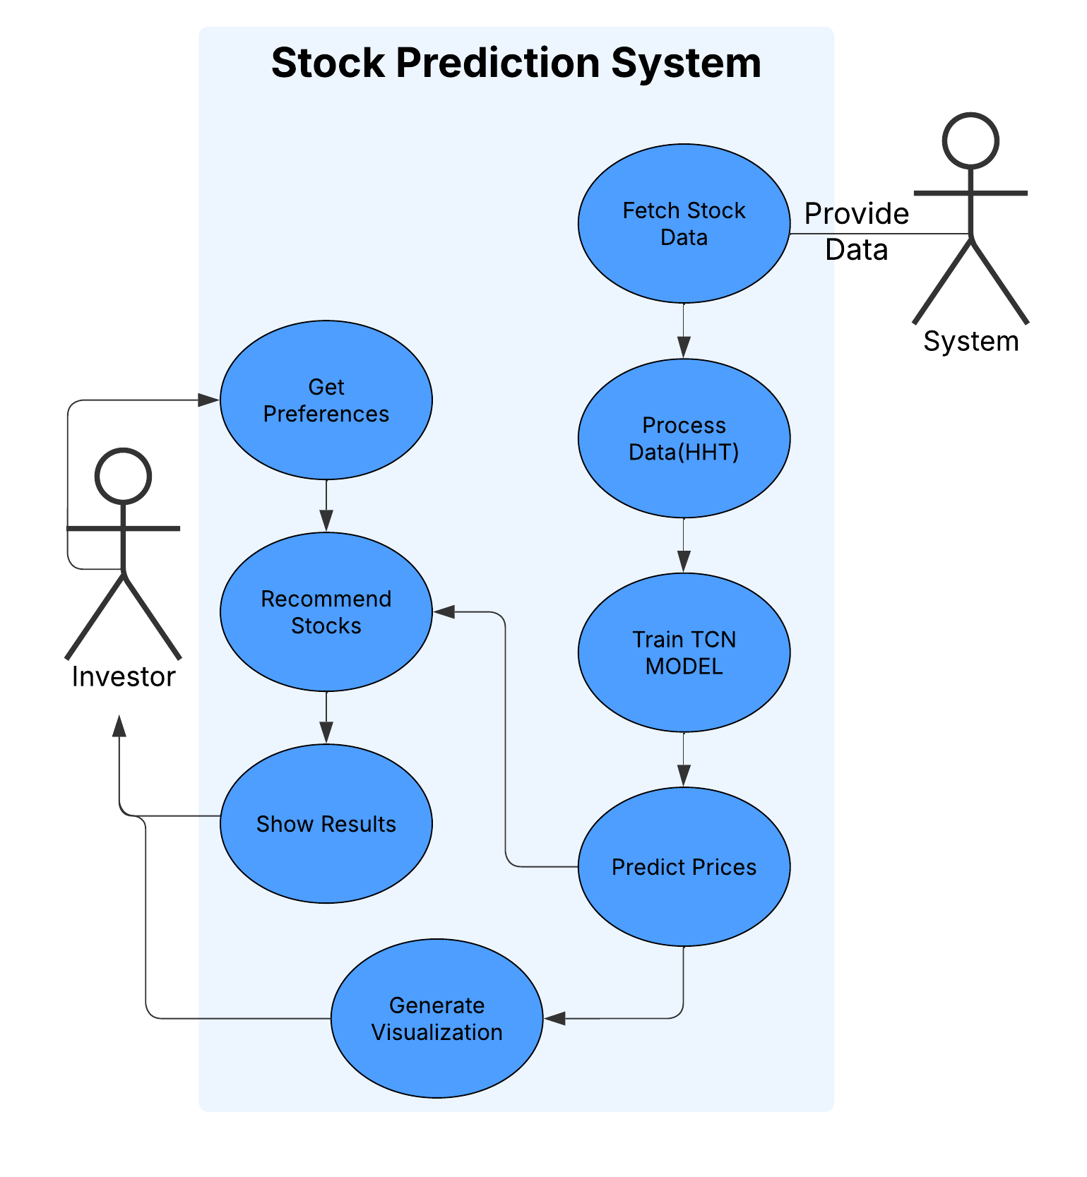
Use Case Diagram

Slide 19
Class Diagram

Slide 20
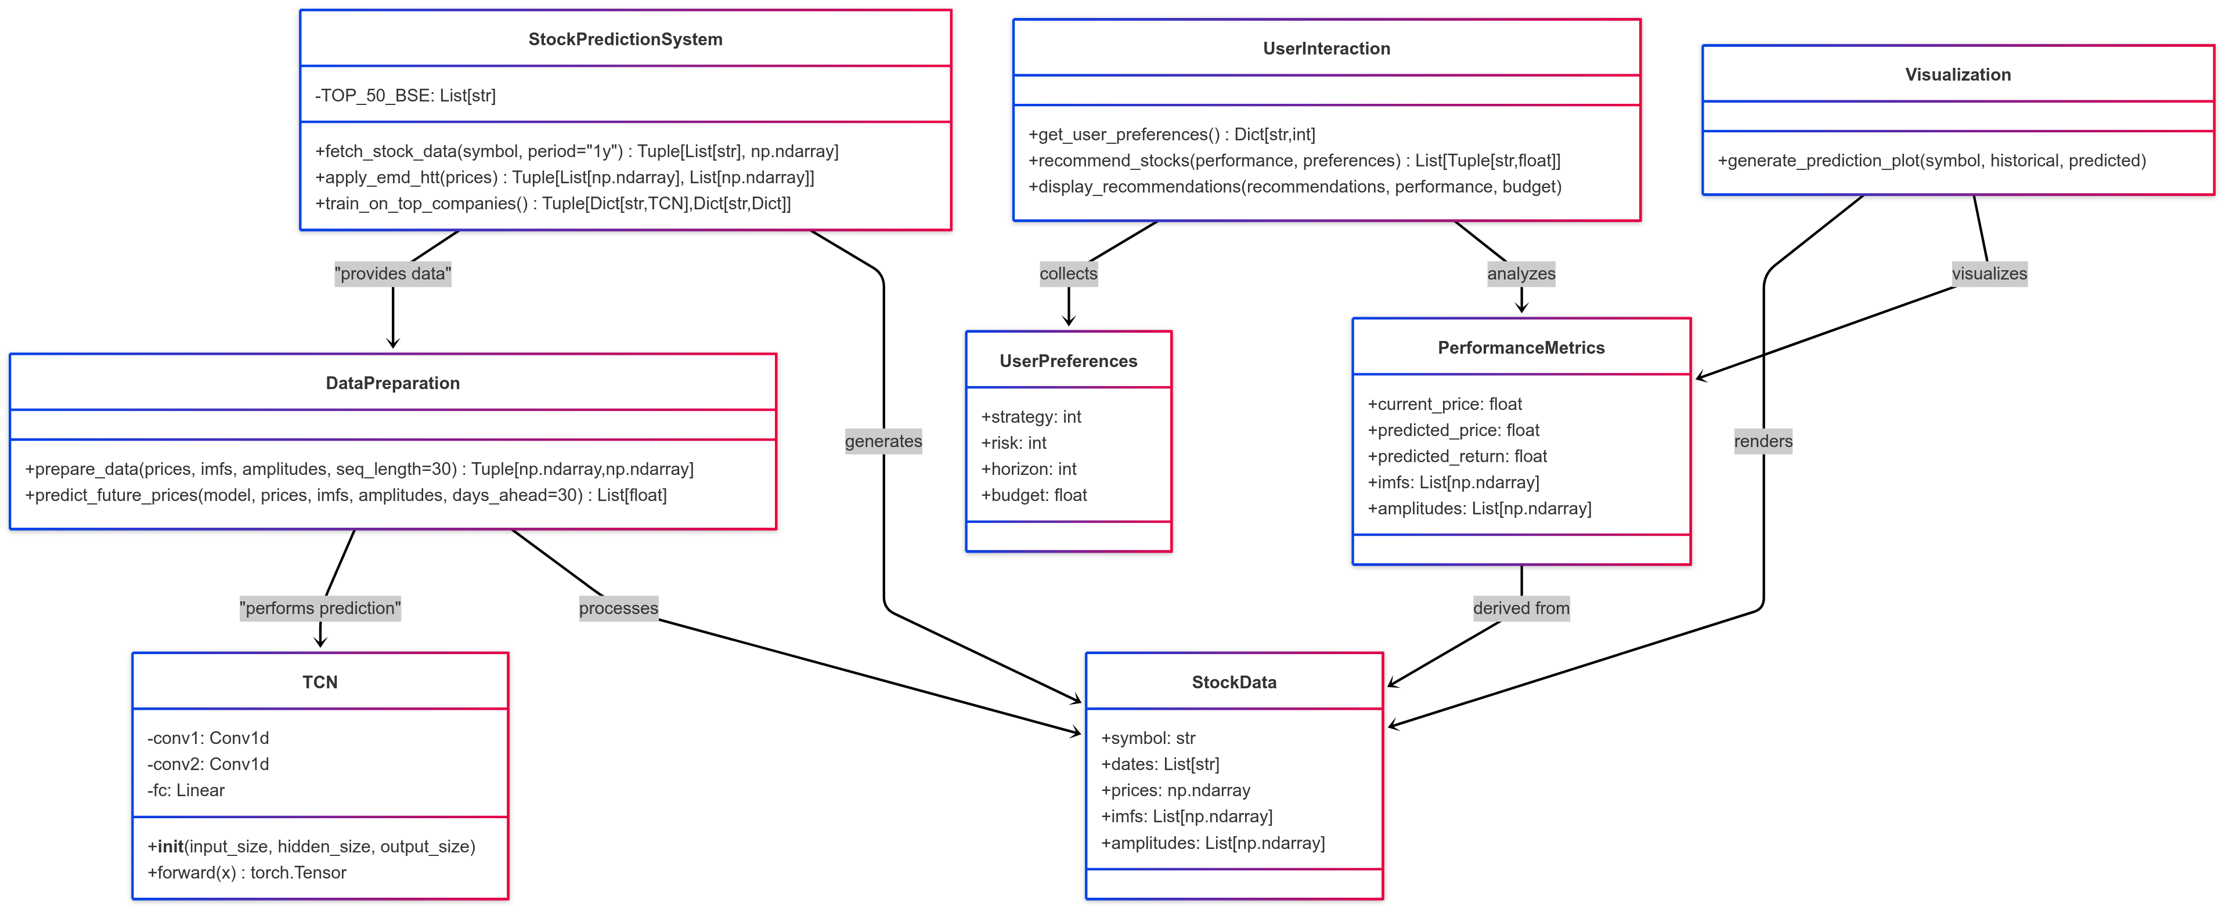

Slide 21
References
S. Palit and C. S. Roy, "Stock Market Prediction Using Machine Learning," IOSR Journal of Computer Engineering (IOSR-JCE), vol. 22, no. 4, pp. 8–17, Jul.–Aug. 2020.
D. Kumar, P. K. Sarangi, and R. Verma, "A Systematic Review of Stock Market Prediction Using Machine Learning and Statistical Techniques," Materials Today: Proceedings, vol. 49, no. 1, pp. 1565–1570, Jan. 2022, doi: 10.1016/j.matpr.2020.11.399.
R. B. Wiranata and A. Djunaidy, "The Stock Exchange Prediction using Machine Learning Techniques: A Comprehensive and Systematic Literature Review," Jurnal Ilmu Komputer dan Informasi, vol. 14, no. 2, pp. 91–112, Jul. 2021, doi: 10.21609/jiki.v14i2.935
M. Durairaj and B. H. Krishna Mohan, "A convolutional neural network based approach to financial time series prediction," Neural Computing and Applications, vol. 34, no. 14, pp. 11599–11614, Jul. 2022, doi: 10.1007/s00521-022-07000-1.

Slide 22
A. Moghar and M. Hamiche, "Stock Market Prediction Using LSTM Recurrent Neural Network," Procedia Computer Science, vol. 170, pp. 1168–1173, 2020, doi: 10.1016/j.procs.2020.03.049.
L. Kumar, A. Pandey, S. Srivastava, and M. Darbari, "A Hybrid Machine Learning System for Stock Market Forecasting," Journal of International Technology and Information Management, vol. 20, no. 1, pp. 39–50, 2011
M. Durairaj and B. H. Krishna Mohan, "A convolutional neural network based approach to financial time series prediction," Neural Computing and Applications, vol. 34, no. 14, pp. 11599–11614, Jul. 2022, doi: 10.1007/s00521-022-07000-1.

Slide 23

Thank You
Thank You

